Slide 1
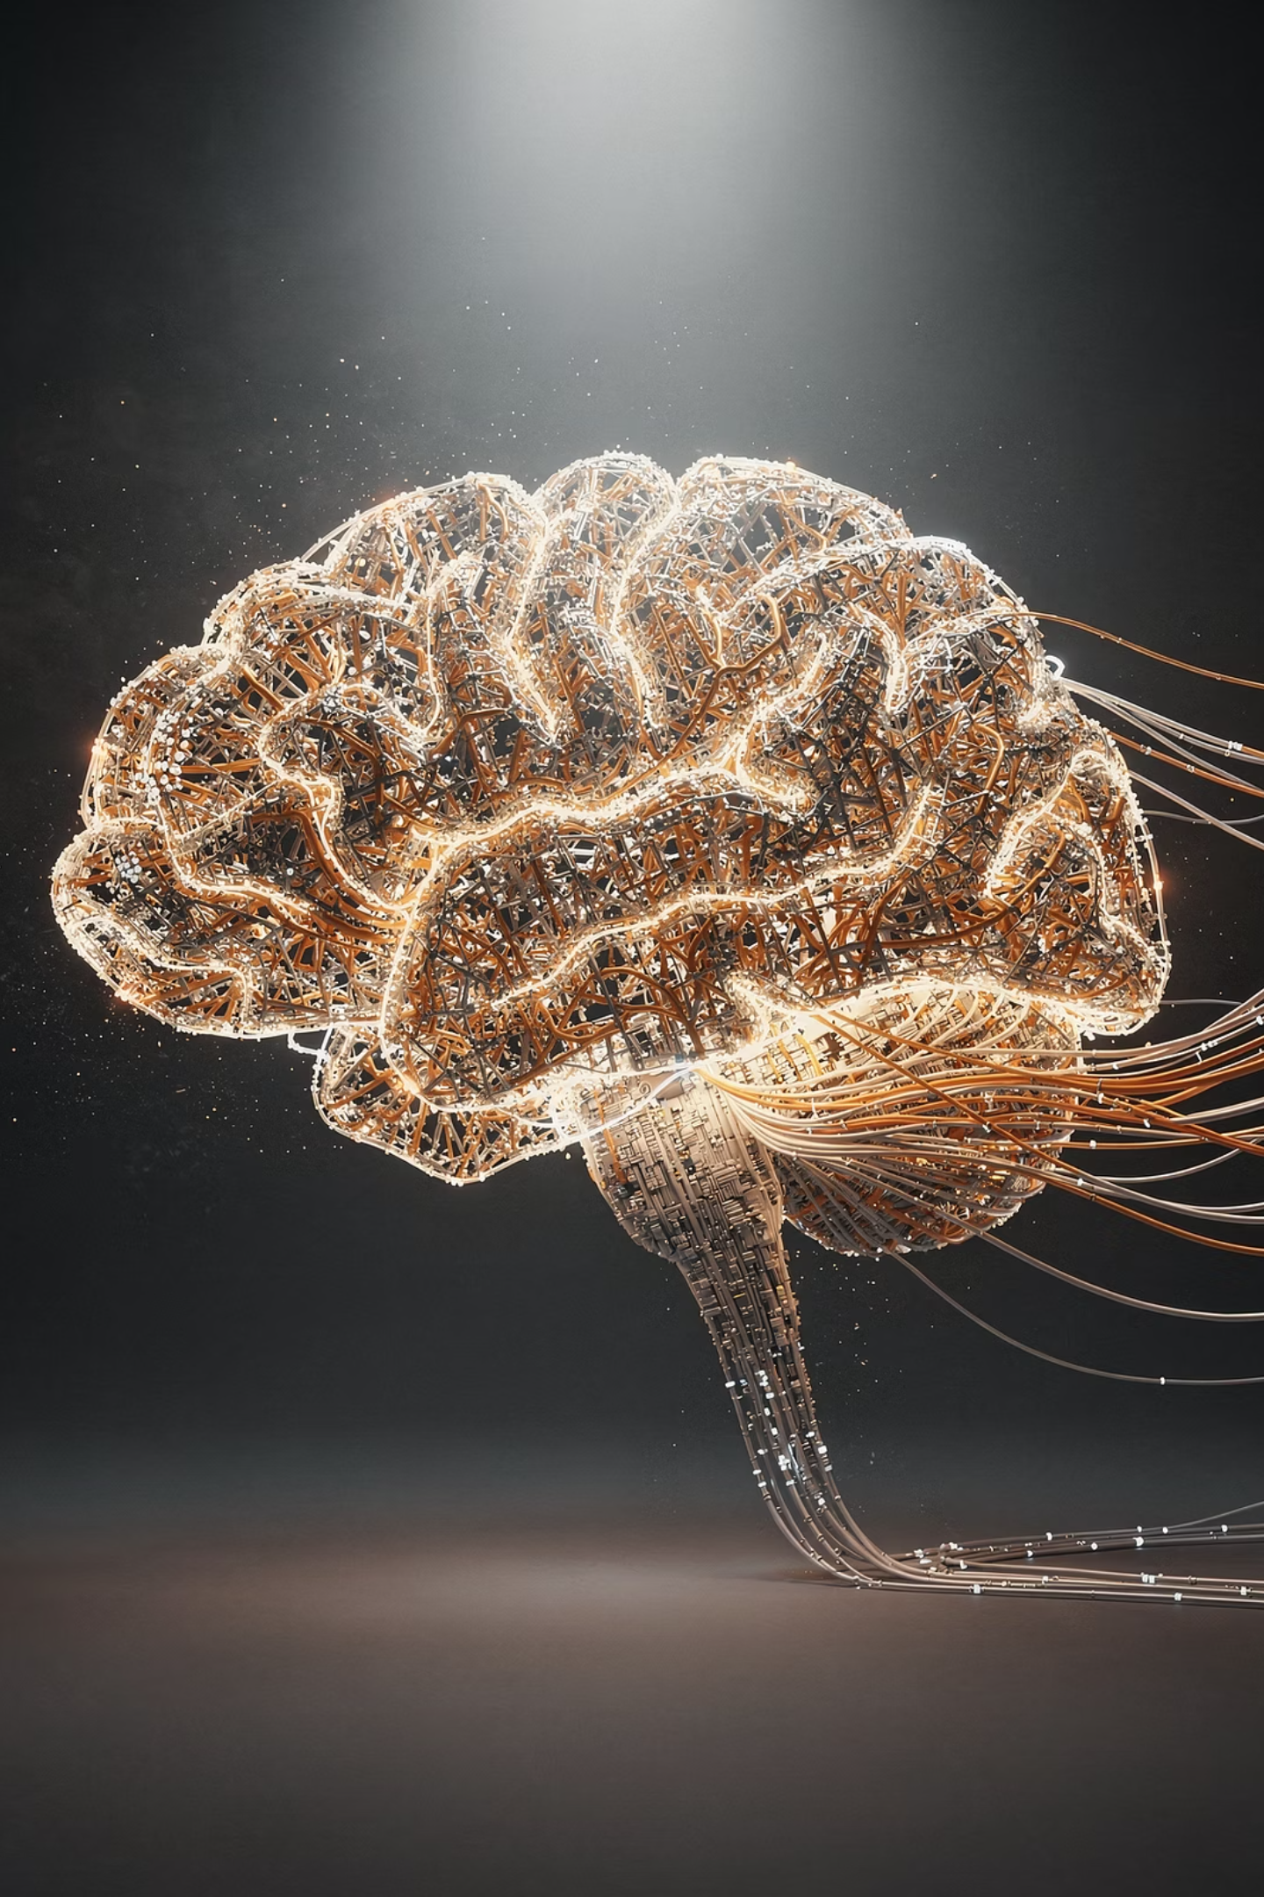
Neural Network Basics
Artificial Neural Networks — Introduction

Slide 2
Contents
01
02
Pigeons as Art Experts
Neural Networks Introduction
How do our brains work?
03
04
Features & Why Neural Networks?
Biological vs Artificial Neuron (Perceptron)
05
06
Perceptron Model & Single Artificial Neuron
Artificial Neural Network (ANN)
Types, Learning, Gradient Descent, Backpropagation, Resilient Backpropagation

Slide 3
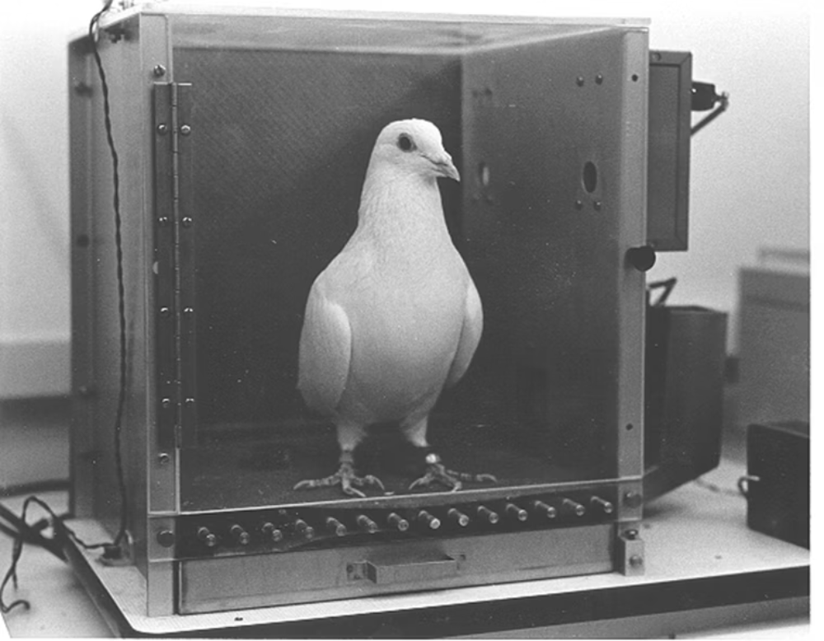
Pigeons as Art Experts
The Experiment
Pigeon placed in a Skinner box
Presented paintings by two artists (e.g. Chagall / Van Gogh)
Rewarded for pecking when shown a particular artist (e.g. Van Gogh)
Results
95% accuracy discriminating Van Gogh from Chagall on trained images
85% accuracy on previously unseen paintings — showing genuine generalization

Slide 4
Pigeons as Art Experts
Pattern Extraction
Generalization
Pigeons do not simply memorize the pictures — they can extract and recognize patterns (the "style").
They generalize from already seen examples to make predictions on new, unseen data.
What This Tells Us
This is what neural networks (biological and artificial) are good at — unlike conventional computers.

Slide 5
Neural Networks Introduction
What Is an ANN?
Inputs
Activation Function
An Artificial Neural Network (ANN) is a machine learning approach that models the human brain and consists of a number of artificial neurons.
Each neuron in an ANN receives a number of inputs from other neurons or raw data.
An activation function is applied to the weighted sum of inputs
( plus bias), producing the output.

Slide 6

How Do Our Brains Work?
The Brain is a massively parallel information processing system. Our brains are a huge network of processing elements. A typical brain contains a network of 86 billion neurons.

Slide 7






Features of Neural Networks
Massive Connectivity
Nonlinear, Parallel & Robust
Neurons are densely interconnected, enabling rich
information flow.
Processes information in parallel and is fault tolerant.
Adaptive
Generalization
Capable of adapting to surroundings and learning from
experience.
Learns from known examples and generalizes to unseen data.
Collective Behavior
Biological Mimicry
Collective behavior is different from individual neuron
behavior.
ANNs mimic key properties of biological neural networks.

Slide 8
Why Neural Networks?
There are two basic reasons why we are interested in building artificial neural networks (ANNs):
Technical Viewpoint
Biological Viewpoint
Some problems such as character recognition or the prediction of future states of a system require massively parallel and adaptive processing.
ANNs can be used to replicate and simulate components of the human (or animal) brain, thereby giving us insight into natural information processing.

Slide 9
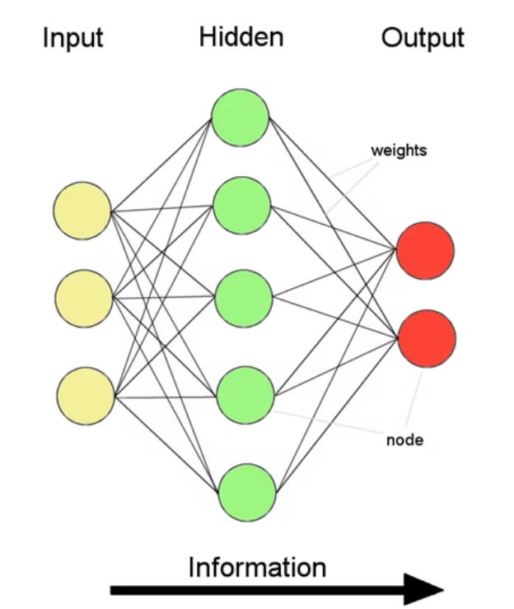
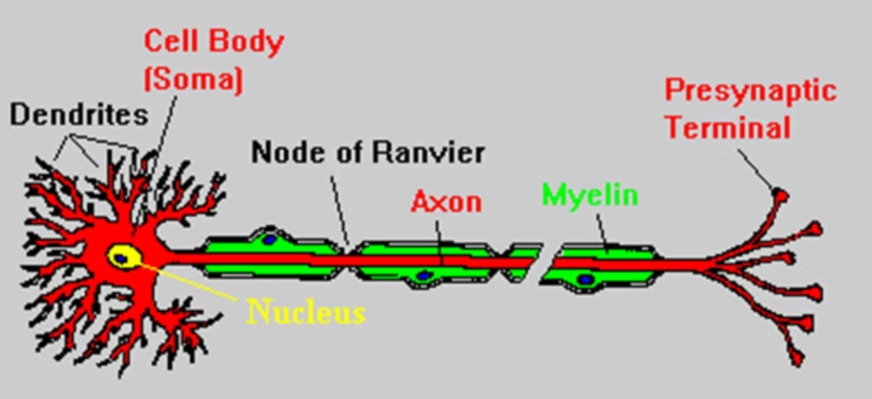
Biological Neuron vs. Artificial Neuron (Perceptron)
Artificial Neural Network
Biological Neuron
Information flow is unidirectional
Data is presented to Input layer → Hidden Layer → Output layer
Information is distributed and processing is parallel
Network function f: R³ → {0, 1}²

Slide 10
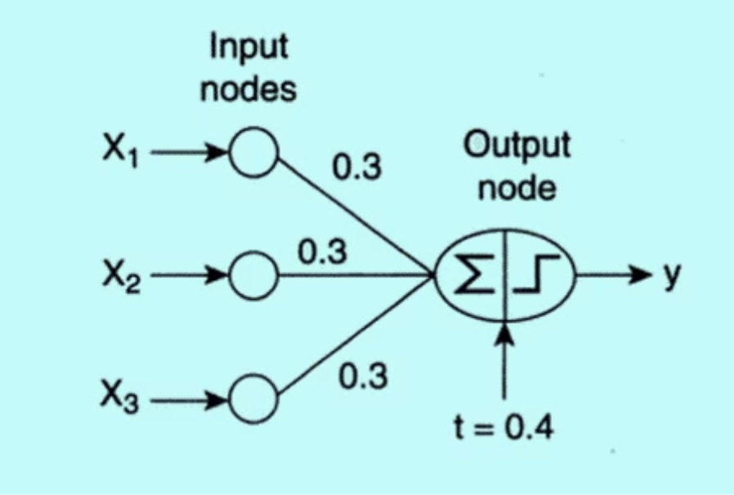
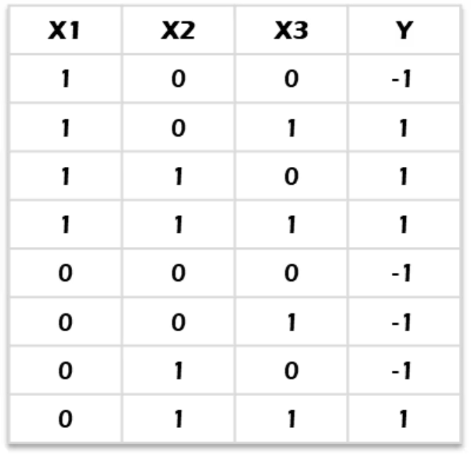
Perceptron Model
Consider data with 3 Boolean variables X1, X2, X3 and an output variable y.
A perceptron is a simple artificial neuron that computes a weighted sum of inputs (along with a bias) and uses a step (sign) activation
function to produce a binary output.
Data
Perceptron
y = 1 if 0.3X₁ + 0.3X₂ + 0.3X₃ − 0.4 > 0;
-1 if 0.3X₁ + 0.3X₂ + 0.3X₃ − 0.4 < 0.
The perceptron consists of two types of nodes: input nodes representing attributes, and an output node representing the model output.
It computes a weighted sum of inputs, subtracts a bias factor, and examines the sign of the result.

Slide 11

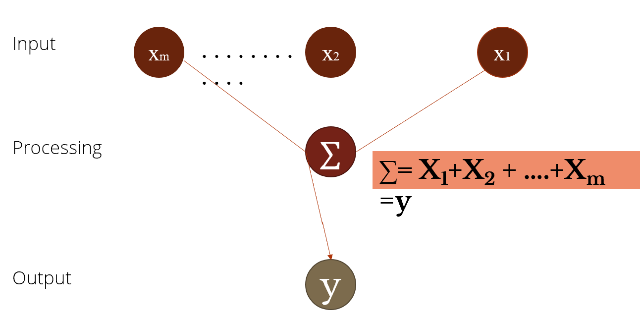


A Single Artificial Neuron — Step 1: Basic Summation
Input
x₁, x₂, … xₘ — raw signals fed into the neuron
Processing (∑)
All inputs are summed: ∑ = X₁ + X₂ + … + Xₘ = y
Output
y — the result passed forward

Slide 12



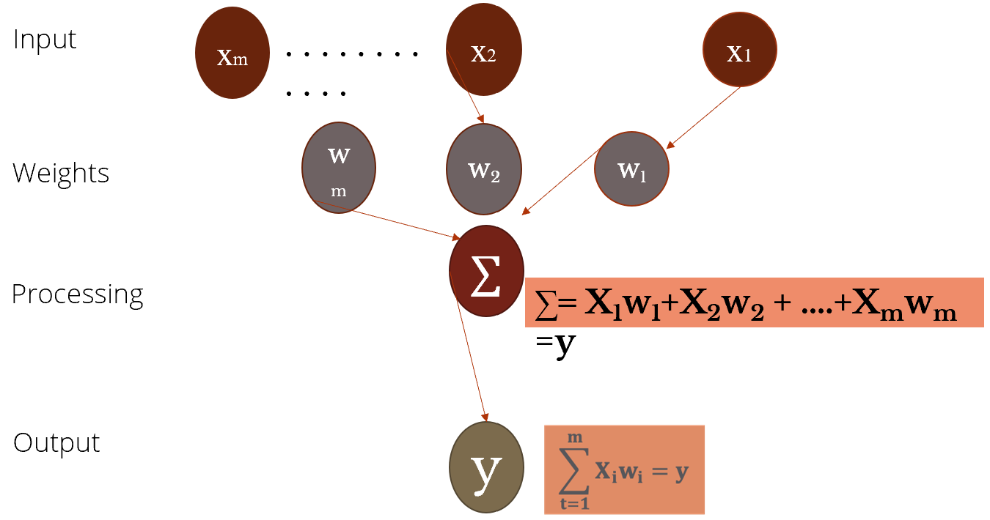


A Single Artificial Neuron — Step 2: Weighted Inputs
Input
Why Weights Matter
x₁, x₂, … xₘ — raw signals
Weights determine how much influence each input has on the output. During training, the network learns by adjusting these weights to minimize error.
Weights
w₁, w₂, … wₘ — each input is scaled by its importance
Processing (∑)
∑ = X₁w₁ + X₂w₂ + … + Xₘwₘ = y
Output
y — weighted sum result

Slide 13
A Single Artificial Neuron — Step 3: Activation Function
Input
Weights
Processing (∑)
x₁, x₂, … xₘ
w₁, w₂, … wₘ scale each input signal
Weighted inputs are summed together( plus bias)
Transfer Function
Output
f(vk) — the activation function transforms the sum
y — final neuron output
The activation (transfer) function f(vk) introduces non-linearity, enabling the network to learn complex patterns beyond simple linear relationships.

Slide 14
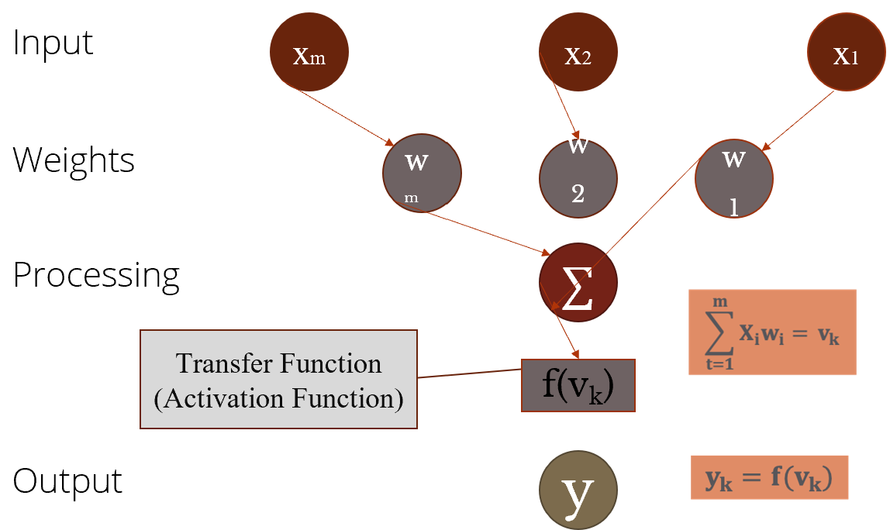
A Single Artificial Neuron — Full Model
Input
Weights
Summation
Activation

Slide 15
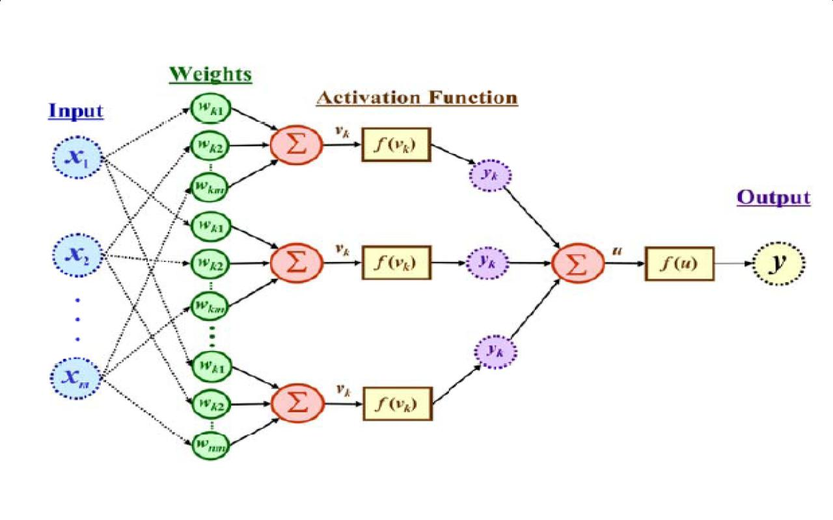
The Output Is a Function of Inputs, Weights & Transfer Functions
Multiple neurons in the middle → hidden layer
Each neuron has its own: weighted sum (Σ)
and activation function f(vk)
Outputs from hidden neurons combine → final output neuron

Slide 16
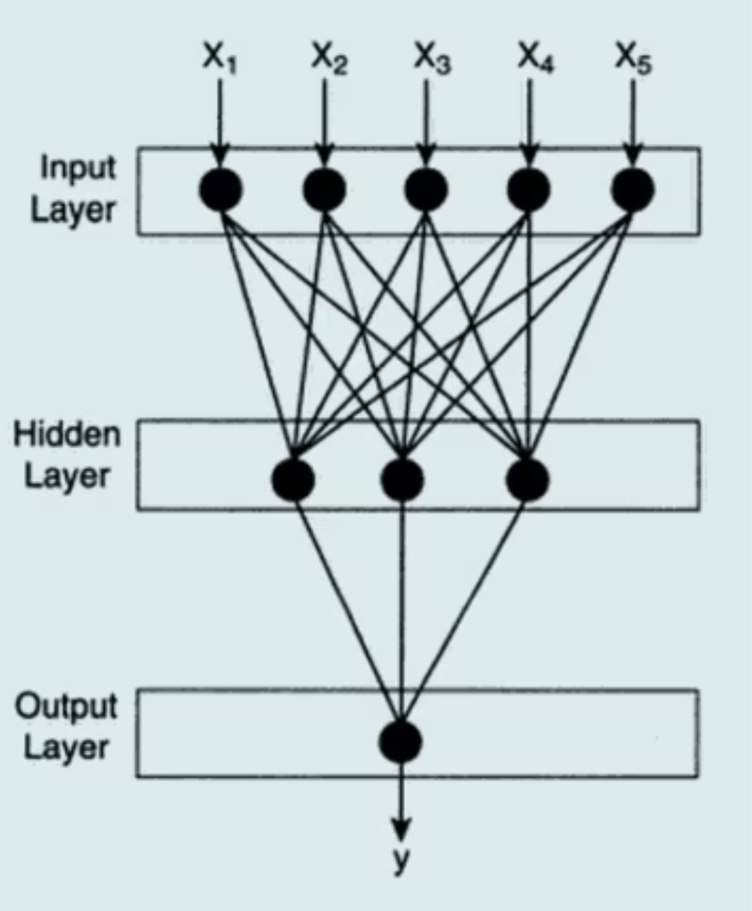
ANN With Hidden Layers
A neural network is more complex than a perceptron model in multiple ways.
Networks may contain several hidden layers between input and output layers; nodes within are called hidden nodes. This is a multilayer neural network.
In a feed-forward network, nodes in one layer connect only to nodes in the next layer.
In a recurrent network, links may connect nodes within the same layer or back to previous layers.

Slide 17
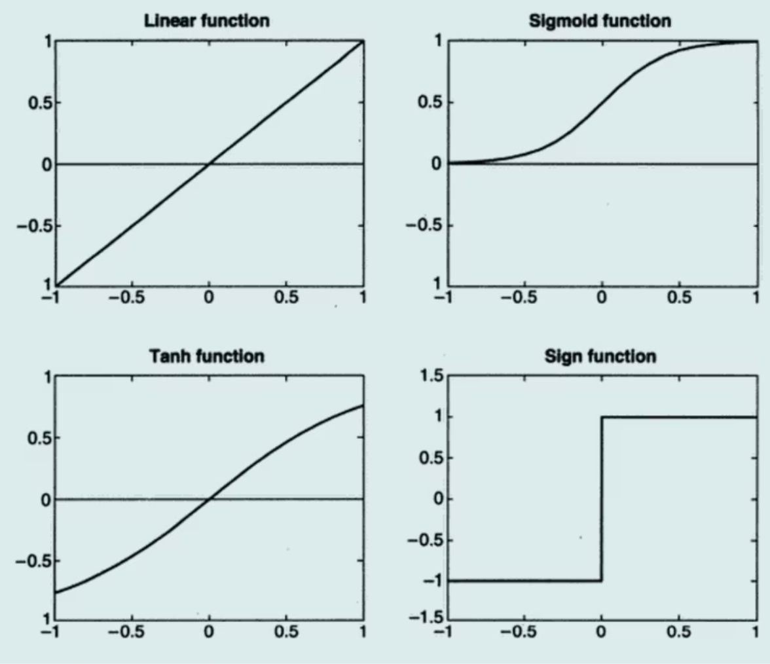
Quick Note on Activation Functions
DETAILS IN NEXT SESSION
ANNs may use activation functions other than the sign function. Examples include: Linear, Sigmoid and Tanh
These additional complexities allow multilayer neural networks to model more complex relationships between input and output variables.
Linear
Sigmoid
Hyperbolic Tangent (Tanh)
Sign

Slide 18
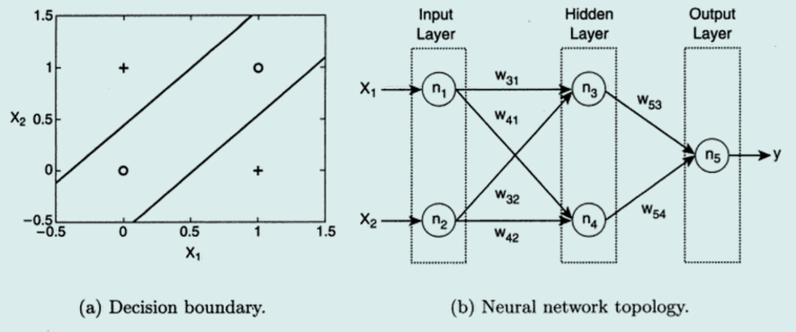
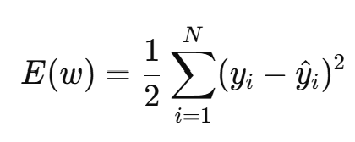
Learning ANN
:
• In ANN, we determine set of weights w that minimize total sum of squared errors.
• Minimum solution can be obtained by replacing y = w · x in the above equation.
• In most cases, output of ANN is non-linear function of its parameters, because of the choice of its activation.
• We use gradient descent method to efficiently solve optimization problem. Since the error surface is usually
nonlinear and may contain multiple minima, Gradient Descent typically converges to a local minimum.

Slide 19
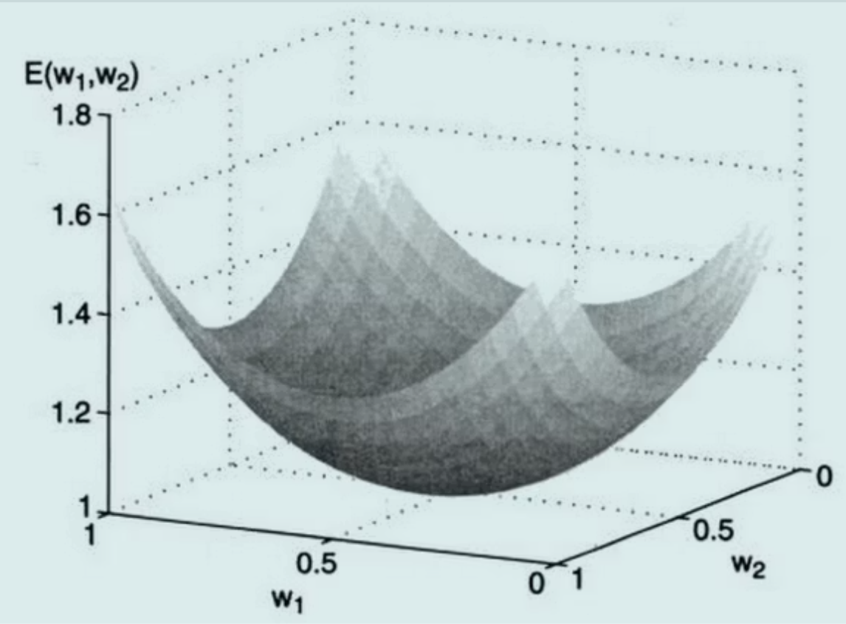

Gradient Descent Method
Gradient Descent minimizes the error surface E(w₁, w₂) by iteratively updating weights in the direction that reduces overall error:
Where λ is the learning rate. The second term states that the weight should be increased in a direction that reduces the overall error, guiding the model toward the minimum of the error surface.

Slide 20
Backpropagation
01
02
03
The Challenge
Forward Phase
Backward Phase
For hidden nodes, the error term cannot be assessed without prior information of weights, making computation complex.
Compute the output value of each neuron using the previous iteration's weights. Computation progresses forward — outputs at level k are computed before level k+1.
The weight update formula is applied in reverse — weights at level k+1 are updated before level k. Errors at layer k+1 are used to estimate errors at layer k.
Backpropagation is an algorithm that computes the gradient of the loss function with respect to each network weight by
propagating error backward through the layers using the chain rule.

Slide 21
Key Takeaways
An Artificial Neural Network (ANN) is a machine learning model inspired by the structure and functioning of the human brain and is composed of interconnected artificial neurons.
In ANN training, the objective is to determine a set of weights that minimizes the total prediction error, often measured using the sum of squared errors.
Since neural networks are nonlinear models, optimization techniques such as Gradient Descent are used to iteratively update the weights in order to reduce the loss function.
To efficiently compute the gradients required for weight updates, the Backpropagation algorithm is used, which propagates the error backward through the hidden layers of the network.

